Slide 1
Extended Spectrum DOCSIS®
A Much Different RF Spectrum Upgrade
September 2020

Slide 2

Future of Coax Cable
There is a long lifetime for existing coaxial network.
DOCSIS 4.0 specification is defining the next steps
There are several ideas for the next 10…20 years, how to meet requirements of increasing capacity
Even 25…35 Gbps (DS+US) is possible to reach
DOCSIS 4.0
  FDX
  1.8 GHz ESD
  Ultra High Split
3 GHz ESD
20G
30G
FDX amplifier
3 GHz + FDX
Soft FDX
  Static
  Dynamic
6 GHz ?

Slide 3
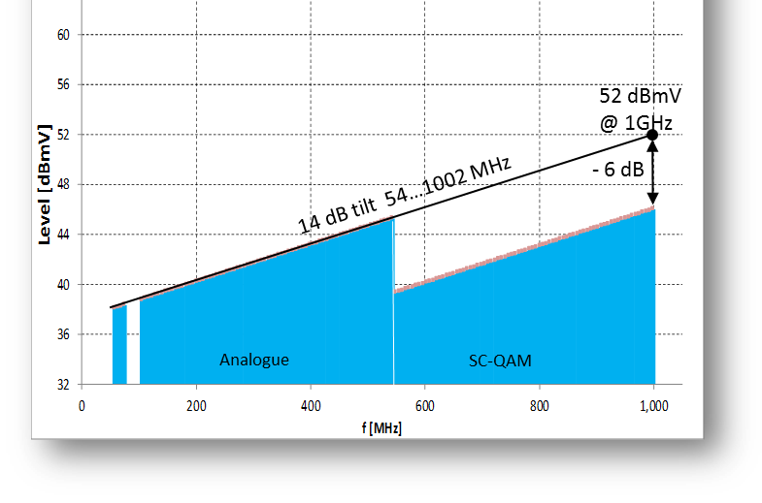
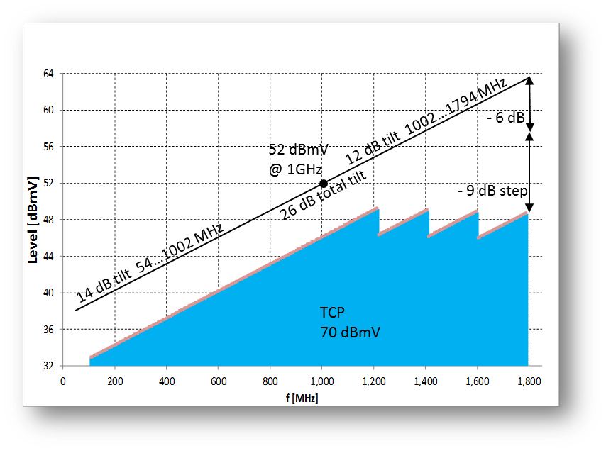
Amplifier RF Level and TCP
RF Level is the signal strength at a particular frequency.
TCP (Total Composite Power) is the area under the Level vs Frequency plot.
Previous RF Spectrum upgrades were able to increase TCP to cover the additional spectrum. Today’s components are not capable of extending that slope up to 1.8 GHz.
However, we can still leverage the TCP that is available.
  Remove all analog signals.
  Remove in home splitter.
  Leverage the robust power of 3.1 OFDM and allow lower input levels.
Notes:
Newish vocapulary says ‘step down’, which describes same phenomen as ‘back-off’.
Estimated max loss between amplifier stations is 56 dBmV – 10 dBmV = 46 dB = required gain in amplifier.
Total power available is 70 dBmV. Existing channel levels (can be lowest channels and new slope value) comes as given (same as earlier). Then we extrapolate rest of available power between 862 and 1.8 Ghz. Target is also have as high as possible virtual level because that allows longest possible coax cable lenghts.
Start and end point are «given», then max TCP is adjusted by means of back-offs. How to arrange back-offs above 1.2 GHz?
TCP would be with real 56 dBmV 4 dB higher.

Slide 4
Method – how to manage TCP
Back-off for >1.2 GHz OFDM signals made by RPD module
Lower TCP
CM sees a flat level until 1.2 GHz and above OFDM blocks up to 1.8 GHz with different back-offs
Back-off changes possible
RPD node
Coax network
Home
RPD
module
CM
1.2 GHz
1.2 GHz
1.2 GHz
1.2 GHz
Notes:
This would be new method, that is not yet in RPD specs. RPD modulator creates needed back-off. This has bit less RF power than method 2. As each 192 MHz block has flat response within channel.
In the module output is bit lower MER compared to method 2. Lower levels leads signal to closer to DA converter’s bottom noise.
Note, phase noise remain same in both methods, only amplitude related noise varies. Anyways, output stage dominates MER. E.g. hybrids 40 dBs vs. modulators 50 dBs.

Slide 5
RF Spectrum Upgrade to 1.8 GHz
Previous RF Spectrum Upgrades
Upgrades were accomplished with more TCP
Continue RF Level Slope towards higher frequencies
Meet minimum CNR/MER requirements for 64/256 QAM
Any additional MER performance was headroom… not necessarily more bits.
RF Spectum Upgrade to 1.8 GHz
Additional TCP is not readily available.
Docsis 3.1 OFDM has enabled higher and flexible modulation.
Reduced input level at the higher frequencies will result in significant bandwidth.
Improved input levels (higher MER) will enable higher modulation and more bits in the pipe.

Slide 6
Throughput data comparison
10.6 Gbps
9.4 Gbps
1.4 Gbps
4 X
4096
OFDM
3.8 Gbps
24 x
SC QAM
27 x
SC QAM
4096
OFDM
4096
OFDM
2048
OFDM
1024
OFDM
512
OFDM
Signal level +/- 2 dB (generally resulting in +/- 2dB MER) will result in significant difference in throughput
A system that can better stabilize signal levels will result in more throughput.
More throughput means more $ Income
Note. 46 Mbps used for SC-QAM and 2.1 Gbps 4096OFDM
Notes:
What do these two cases mean in terms of all-IP data throughtput and back-offs above 1.2 GHz.
In the 1. 8 GHz case on right hand side, all OFDM back-offs are aligned so what TCP still allows.
Existing channels are on same level in both cases. US capacity is 2,7X on 1.8 GHz case.

Slide 7
RF Spectrum Conclusion
TCP (Total Composite Power) will be limited.
Robust flexible nature of D3.1 OFDM will enable optimization of modulation.
RF input level at the home will have a direct impact MER and modulation.
A system that can maximize and stabilize the RF level at the home will enable higher modulation.
Next generation RF equipment should include intelligent automation.
    Auto level control.
    Real time closed loop feedback systems for RF level and slope.
    Software tools to monitor, report, and self correct will enable higher modulation.
Higher modulation = More bandwidth

